Slide 1
Legend
B04B01036 林妤真

Slide 2
Description
Creates a legend with descriptive labels for each plotted data series.
The legend automatically updates when you add or delete data series from the axes. This command creates a legend for the current axes or chart returned by gca. If the current axes are empty, then the legend is empty. If axes do not exist, then this command creates them.
Notes:
一個軸只能加一個，但若有sub 可指定要放在哪個sub內
legend creates a legend with descriptive labels for each plotted data series.

Slide 3
Syntax
legend
legend(label1,...,labelN)
legend(labels)
legend(subset,___)
legend(target,___)
legend(___,'Location',lcn)
legend(___,'Orientation',ornt)
legend(___,Name,Value)
legend(bkgd)
lgd = legend(___)
legend(vsbl)
legend('off')
Notes:
一個軸只能加一個，但若有sub 可指定要放在哪個sub內
legend creates a legend with descriptive labels for each plotted data series.

Slide 4
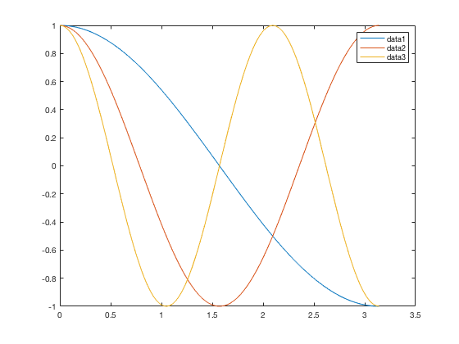
x = linspace(0,pi);
y1 = cos(x);
plot(x,y1)
hold on
y2 = cos(2*x);
plot(x,y2)
y3 = cos(3*x);
plot(x,y3)
hold off
legend
legend
Notes:
If the DisplayName property is empty, then the legend uses a label of the form 'dataN'.

Slide 5
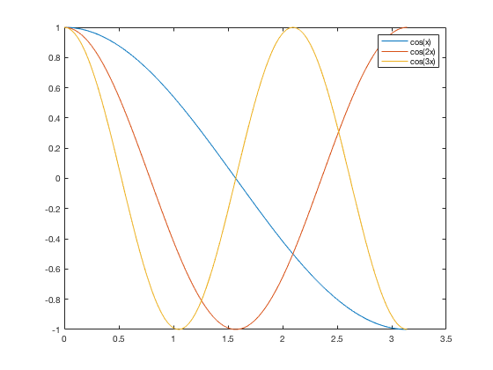
x = linspace(0,pi);
y1 = cos(x);
plot(x,y1 ,'DisplayName','cos(x)');
hold on
y2 = cos(2*x);
plot(x,y2,'DisplayName','cos(2x)')
y3 = cos(3*x);
plot(x,y3,'DisplayName','cos(3x)')
hold off
legend
legend
Notes:
% 5
clear;clc;
x = linspace(0,pi);
y1 = cos(x);
plot(x,y1 ,'DisplayName','cos(x)');
hold on
y2 = cos(2*x);
plot(x,y2,'DisplayName','cos(2x)')
y3 = cos(3*x);
plot(x,y3,'DisplayName','cos(3x)')
hold off
legend

Slide 6

x = linspace(0,pi);
y1 = cos(x);
plot(x,y1)
hold on
y2 = cos(2*x);
plot(x,y2)
y3 = cos(3*x);
plot(x,y3)
hold off
legend('cos(x)','cos(2x)’,'cos(3x)')
legend(label1,...,labelN)
Notes:
% 6
clear;clc;
x = linspace(0,pi);
y1 = cos(x);
plot(x,y1)
hold on
y2 = cos(2*x);
plot(x,y2)
y3 = cos(3*x);
plot(x,y3)
hold off
legend('cos(x)','cos(2x)','cos(3x)')

Slide 7

x = linspace(0,pi);
y1 = cos(x);
plot(x,y1)
hold on
y2 = cos(2*x);
plot(x,y2)
y3 = cos(3*x);
plot(x,y3)
hold off
legend({'cos(x)','cos(2x)’,'cos(3x)'})
legend(labels)
Notes:
% 7
clear;clc;
x = linspace(0,pi);
y1 = cos(x);
plot(x,y1)
hold on
y2 = cos(2*x);
plot(x,y2)
y3 = cos(3*x);
plot(x,y3)
hold off
legend({'cos(x)','cos(2x)','cos(3x)'})

Slide 8
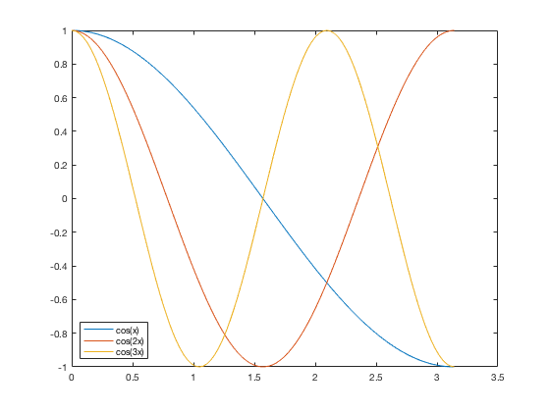
x = linspace(0,pi);
y1 = cos(x);
plot(x,y1)
hold on
y2 = cos(2*x);
plot(x,y2)
y3 = cos(3*x);
plot(x,y3)
hold off
legend({'cos(x)','cos(2x)','cos(3x)'},'Location','southwest’)
legend(___,'Location',lcn)
legend(___,'Location',lcn)
Notes:
% 8
clear;clc;
x = linspace(0,pi);
y1 = cos(x);
plot(x,y1)
hold on
y2 = cos(2*x);
plot(x,y2)
y3 = cos(3*x);
plot(x,y3)
hold off
legend({'cos(x)','cos(2x)','cos(3x)'},'Location','southwest')

Slide 9
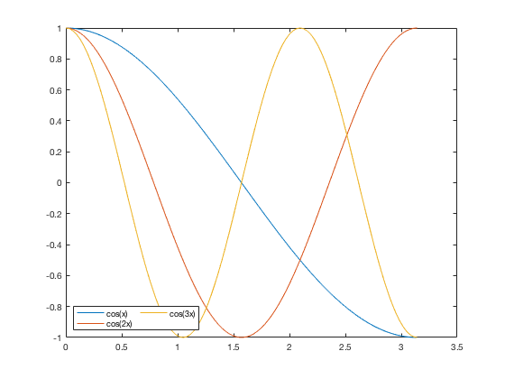
x = linspace(0,pi);
y1 = cos(x);
plot(x,y1)
hold on
y2 = cos(2*x);
plot(x,y2)
y3 = cos(3*x);
plot(x,y3)
hold off
legend({'cos(x)','cos(2x)','cos(3x)'},'Location','southwest',
'NumColumns',2)
legend(___,’Name',Value)
Notes:
% 9
clear;clc;
x = linspace(0,pi);
y1 = cos(x);
plot(x,y1)
hold on
y2 = cos(2*x);
plot(x,y2)
y3 = cos(3*x);
plot(x,y3)
hold off
legend({'cos(x)','cos(2x)','cos(3x)'},'Location','southwest','NumColumns',2)

Slide 10
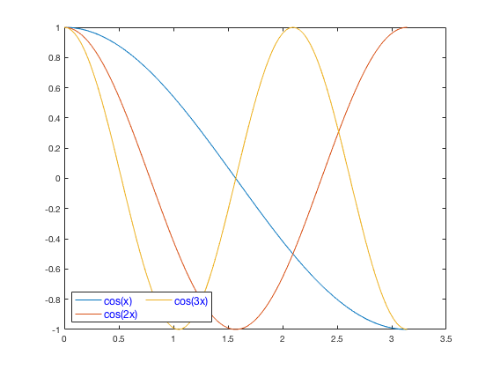
x = linspace(0,pi);
y1 = cos(x);
plot(x,y1)
hold on
y2 = cos(2*x);
plot(x,y2)
y3 = cos(3*x);
plot(x,y3)
hold off
legend({'cos(x)','cos(2x)','cos(3x)'},'Location','southwest',
'NumColumns',2,
'FontSize',12,
'TextColor','blue')
Notes:
%10
clear;clc;
x = linspace(0,pi);
y1 = cos(x);
plot(x,y1)
hold on
y2 = cos(2*x);
plot(x,y2)
y3 = cos(3*x);
plot(x,y3)
hold off
legend({'cos(x)','cos(2x)','cos(3x)'},'Location','southwest','NumColumns',2,'FontSize',12,'TextColor','blue')

Slide 11
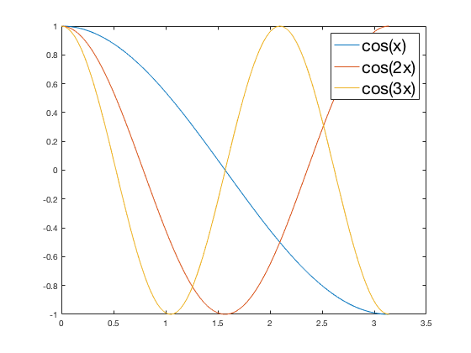
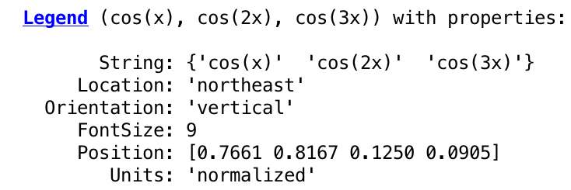
x = linspace(0,pi);
y1 = cos(x);
plot(x,y1)
hold on
y2 = cos(2*x);
plot(x,y2)
y3 = cos(3*x);
plot(x,y3)
hold off
lgd = legend('cos(x)','cos(2x)','cos(3x)');
lgd
lgd.FontSize = 20;
lgd=legend(___)
Notes:
% 11
clear;clc;
x = linspace(0,pi);
y1 = cos(x);
plot(x,y1)
hold on
y2 = cos(2*x);
plot(x,y2)
y3 = cos(3*x);
plot(x,y3)
hold off
lgd = legend('cos(x)','cos(2x)','cos(3x)');
lgd
lgd.FontSize = 20;

Slide 12
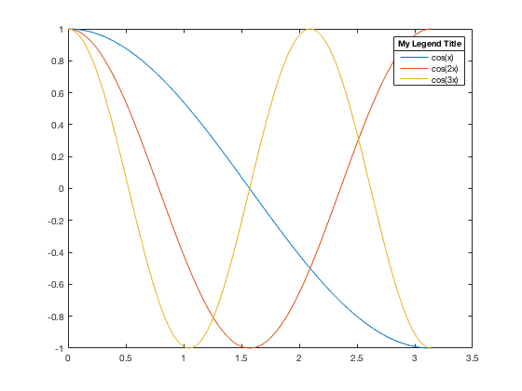
x = linspace(0,pi);
y1 = cos(x);
plot(x,y1)
hold on
y2 = cos(2*x);
plot(x,y2)
y3 = cos(3*x);
plot(x,y3)
hold off
lgd = legend('cos(x)','cos(2x)','cos(3x)');
title(lgd,'My Legend Title');
Notes:
% 12
clear;clc;
x = linspace(0,pi);
y1 = cos(x);
plot(x,y1)
hold on
y2 = cos(2*x);
plot(x,y2)
y3 = cos(3*x);
plot(x,y3)
hold off
lgd = legend('cos(x)','cos(2x)','cos(3x)');
title(lgd,'My Legend Title');

Slide 13
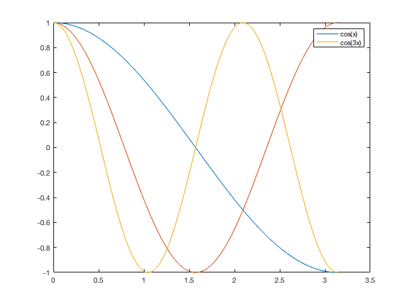
x = linspace(0,pi);
y1 = cos(x);
p1 = plot(x,y1);
hold on
y2 = cos(2*x);
p2 = plot(x,y2);
y3 = cos(3*x);
p3 = plot(x,y3);
hold off
legend([p1 p3],{'cos(x)', 'cos(3x)'})
legend(subset,labels)
Notes:
% 13
clear;clc;
x = linspace(0,pi);
y1 = cos(x);
p1 = plot(x,y1);
hold on
y2 = cos(2*x);
p2 = plot(x,y2);
y3 = cos(3*x);
p3 = plot(x,y3);
hold off
legend([p1 p3],{'cos(x)', 'cos(3x)'})

Slide 14
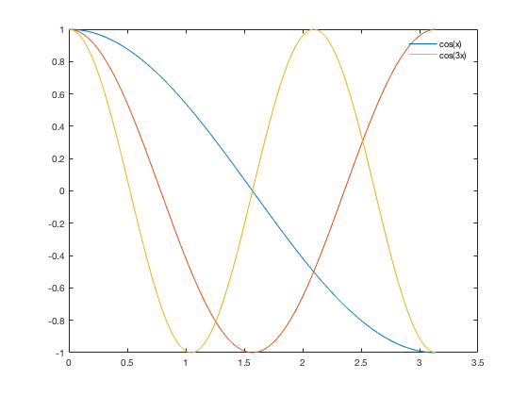
x = linspace(0,pi);
y1 = cos(x);
p1 = plot(x,y1);
hold on
y2 = cos(2*x);
p2 = plot(x,y2);
y3 = cos(3*x);
p3 = plot(x,y3);
hold off
legend([p1 p3],{'cos(x)', 'cos(3x)'})
legend('boxoff')
legend(bkgd)
Notes:
% 14
clear;clc;
x = linspace(0,pi);
y1 = cos(x);
p1 = plot(x,y1);
hold on
y2 = cos(2*x);
p2 = plot(x,y2);
y3 = cos(3*x);
p3 = plot(x,y3);
hold off
legend([p1 p3],{'cos(x)', 'cos(3x)'})
legend('boxoff')

Slide 15

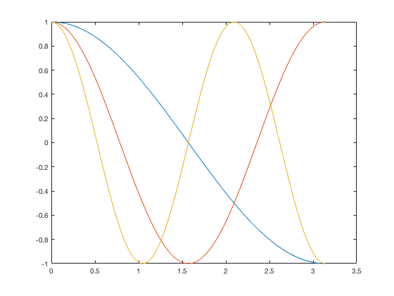
x = linspace(0,pi);
y1 = cos(x);
p1 = plot(x,y1);
hold on
y2 = cos(2*x);
p2 = plot(x,y2);
y3 = cos(3*x);
p3 = plot(x,y3);
hold off
legend([p1 p3],{'cos(x)', 'cos(3x)'})
legend('hide')
legend(vsbl)
legend('show')
legend('toggle)
Notes:
% 15
clear;clc;
x = linspace(0,pi);
y1 = cos(x);
p1 = plot(x,y1);
hold on
y2 = cos(2*x);
p2 = plot(x,y2);
y3 = cos(3*x);
p3 = plot(x,y3);
hold off
legend([p1 p3],{'cos(x)', 'cos(3x)'})
legend('hide') %legend(vsbl) controls the visibility of the legend
legend('show')
legend('toggle')

Slide 16
x = linspace(0,pi);
y1 = cos(x);
p1 = plot(x,y1);
hold on
y2 = cos(2*x);
p2 = plot(x,y2);
y3 = cos(3*x);
p3 = plot(x,y3);
hold off
legend([p1 p3],{'cos(x)', 'cos(3x)'})
legend(’off')
legend(off)
Notes:
% 16
clear;clc;
x = linspace(0,pi);
y1 = cos(x);
p1 = plot(x,y1);
hold on
y2 = cos(2*x);
p2 = plot(x,y2);
y3 = cos(3*x);
p3 = plot(x,y3);
hold off
legend([p1 p3],{'cos(x)', 'cos(3x)'})
legend('off')

Slide 17
Thank you

